Slide 1
What we Cover Today
Sending Email through PHP mail function
Sending Email through PHPMailer

Slide 2
PHP mail() function
The mail() function allows you to send emails directly from a script.
Syntax: mail(to, subject, message, headers, parameters);
Parameter | Description
to | Required. Specifies the receiver / receivers of the email examples are: user@example.com user@example.com, anotheruser@example.com User <user@example.com> User <user@example.com>, Another User <anotheruser@example.com>
subject | Required. Specifies the subject of the email. Note: This parameter cannot contain any newline characters
message | Required. Defines the message to be sent. Each line should be separated with a CRLF (\r\n). Lines should not exceed 70 characters. Windows note: If a full stop is found on the beginning of a line in the message, it might be removed. To solve this problem, replace the full stop with a double dot: <?php $txt = str_replace("\n.", "\n..", $txt); ?>
headers | Optional. Specifies additional headers, like From, Cc, and Bcc. The additional headers should be separated with a CRLF (\r\n).
parameters | Optional. Specifies an additional parameter to the sendmail program (the one defined in the sendmail_path configuration setting). (i.e. this can be used to set the envelope sender address when using sendmail with the -f sendmail option)

Slide 3
PHP Email Setup
Before we can send email with PHP, we need to set it up to do so, just as we need to set up our email program before it can send messages.
If you don’t run your own server, but instead have a PHP-equipped Web host, you can safely assume that everything in this section has been done for you, and skip ahead and jump to the example only.
We can send mail from localhost with sendmail package.
sendmail package is inbuild in XAMPP. So if you are using XAMPP then you can easily send mail from localhost.
For that we first configure C:\xampp\php\php.ini and c:\xampp\sendmail\sendmail.ini for gmail to send mail.
in C:\xampp\php\php.ini find extension=php_openssl.dll and remove the semicolon from the beginning of that line to make SSL working for gmail for localhost.
in php.ini file find [mail function] and change
  SMTP=smtp.gmail.com
  smtp_port=587
  sendmail_from = my-gmail-id@gmail.com
  sendmail_path = "\"C:\xampp\sendmail\sendmail.exe\" -t"

Slide 4
PHP Email Setup
Now Open C:\xampp\sendmail\sendmail.ini and Replace all the existing code in sendmail.ini with the following code:
  [sendmail]
  smtp_server=smtp.gmail.com
  smtp_port=587
  error_logfile=error.log
  debug_logfile=debug.log
  auth_username=my-gmail-id@gmail.com
  auth_password=my-gmail-password
  force_sender=my-gmail-id@gmail.com
Now we have done!! Now we just create php file with mail function and send mail from localhost.
Note: don't forgot to replace my-gmail-id and my-gmail-password in above code. Also, don't forget to remove duplicate keys if you copied settings from above. For example comment following line if there is another sendmail_path in the php.ini file: sendmail_path="C:\xampp\mailtodisk\mailtodisk.exe"
Also remember to restart the server using the XAMMP control panel so the changes take effect.

Slide 5
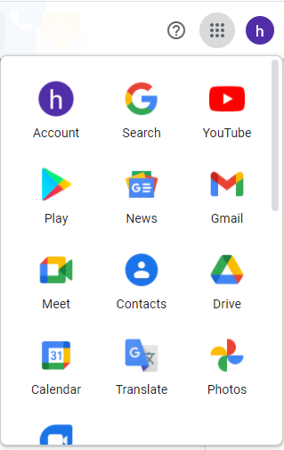
Alternate Less Secure apps in gmail
To using Gmail SMTP server, you should need to generate gmail app password(Alternate Of Less Secure App ) for account access for less secure apps. Don’t worry! Just follow the below steps.
Login to your google account.
Click on ACCOUNT
Click here

Slide 6
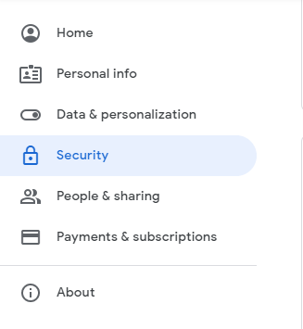
Alternate Less Secure apps in gmail
Click on Security
or you can directly Go to the Less secure apps settings page – https://myaccount.google.com/security

Slide 7
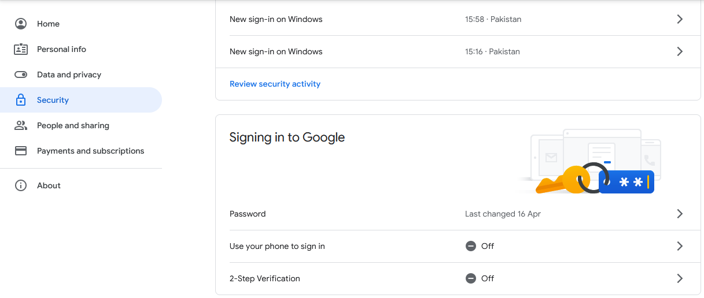
Turn On 2-Step-Verification in gmail

Slide 8
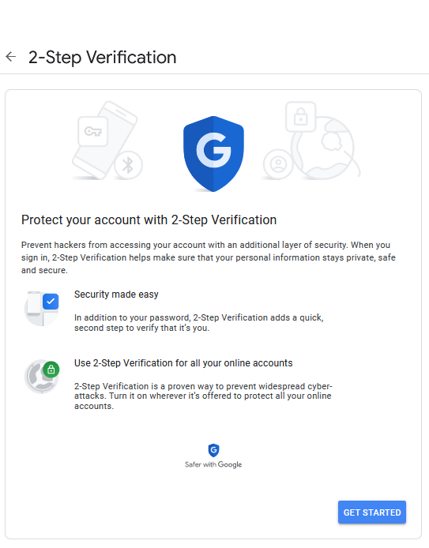
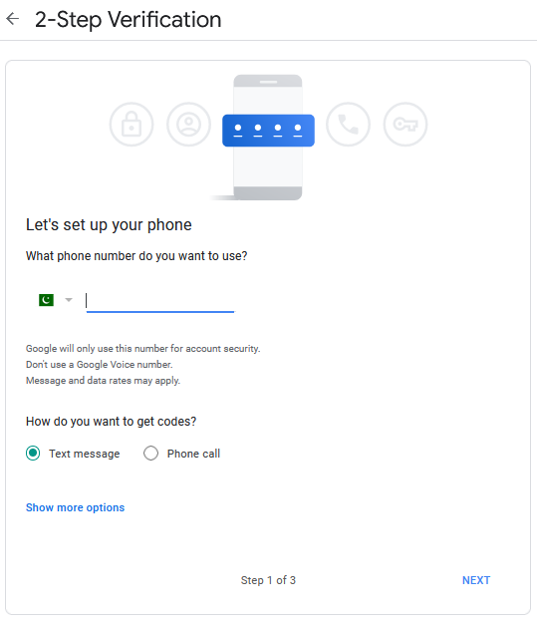
Turn On 2-Step-Verification in gmail
Enter Phone Number
2
1
3

Slide 9
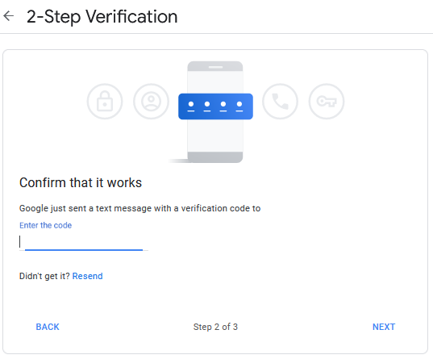
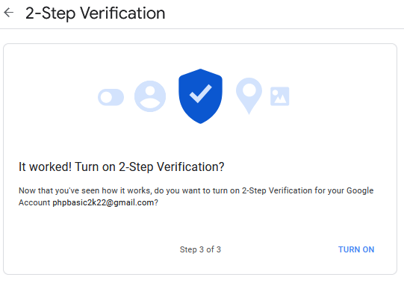
1
2
3

Slide 10
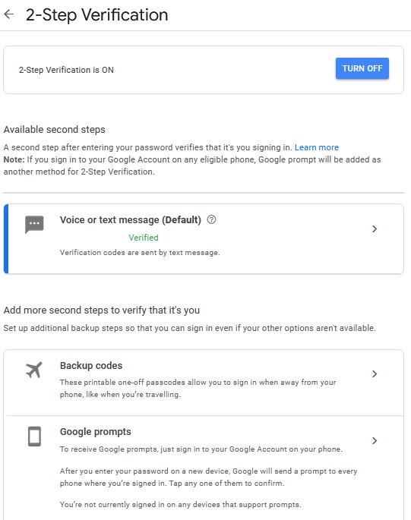

Slide 11
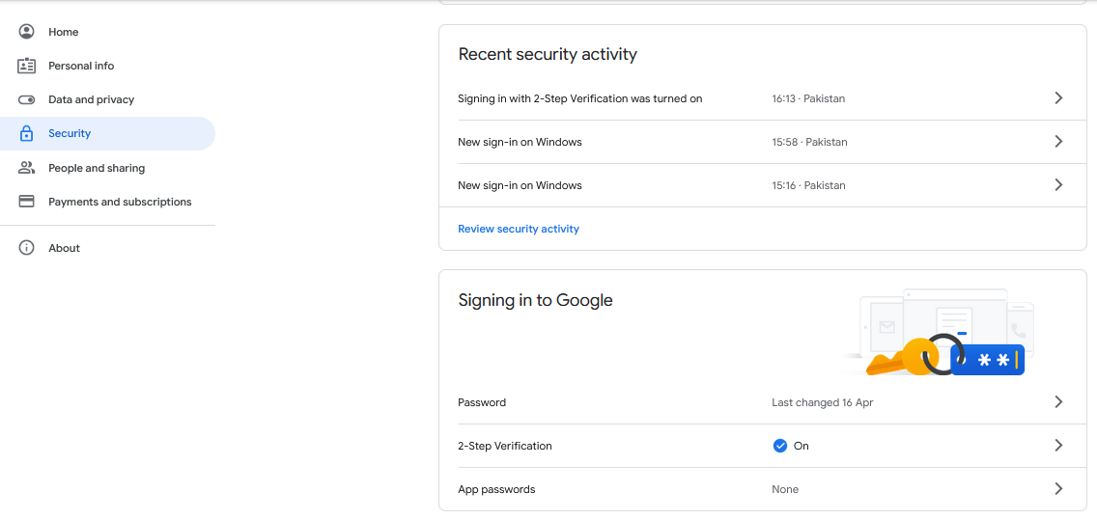
Generate Password

Slide 12
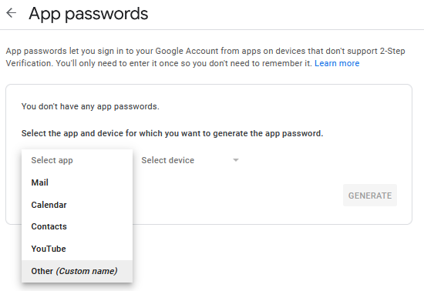
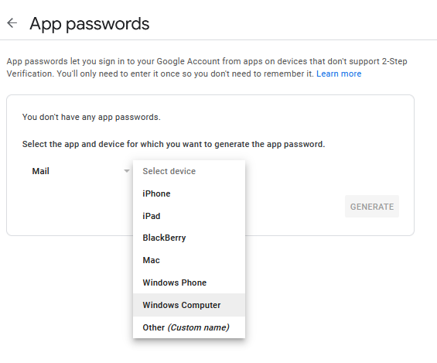
3
1
2

Slide 13
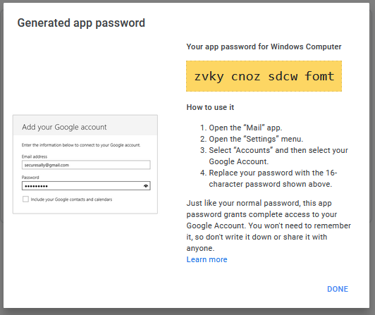
Copy This Password And Paste In Your Code

Slide 14
Examples
Example #1 Sending mail.
Using mail() to send a simple email:
  <?php
  // The message
  $message = "Line 1\r\nLine 2\r\nLine 3";
  // In case any of our lines are larger than 70 characters, we should use wordwrap()
  $message = wordwrap($message, 70, "\r\n");
  // Send
  mail(‘abc@example.com', 'My Subject', $message);
  ?>
Returns TRUE if the mail was successfully accepted for delivery, FALSE otherwise.
It is important to note that just because the mail was accepted for delivery, it does NOT mean the mail will actually reach the intended destination.

Slide 15
Examples
Example #2 Sending mail with extra headers.
Using mail() to send a simple email:
  <?php
  $to = ‘abc@example.com';
  $subject = 'the subject';
  $message = 'hello';
  $headers = 'From: webmaster@example.com' . "\r\n" .
  'CC: webmaster@example.com' . "\r\n";
  mail($to, $subject, $message, $headers);
  ?>

Slide 16
PHPMailer
PHPMailer is a class library for PHP that provides a collection of functions to build and send email messages.
PHPMailer supports several ways of sending email: mail(), Sendmail, qmail & direct to SMTP servers.
You can use any feature of SMTP-based e-mail, multiple recepients via to, CC, BCC, etc.

Slide 17
why use PHPMailer?
PHP has a built-in mail() function. So why use PHPMailer?
Because before you can send a message you have to construct one correctly, And this is extremely complicated because there are so many technical considerations.
PHPMailer makes it easy to send e-mail, makes it possible to attach files, send HTML e-mail, etc.
Because using mail() has so many hidden problems, it is strongly suggestion from phpmailer developer that, if you don't want to use PHPMailer, use another established email library such as SwiftMailer, Zend_Mail etc.
For more detail/documentation and for download visits:
https://github.com/PHPMailer/PHPMailer/

Slide 18
Examples
Example #1
  <?php
  /**
  * This example shows settings to use when sending via Google's Gmail servers.
  * This uses traditional id & password authentication - look at the gmail_xoauth.phps
  * example to see how to use XOAUTH2.
  * The IMAP section shows how to save this message to the 'Sent Mail' folder using IMAP commands.
  */
  //Import PHPMailer classes into the global namespace
  use PHPMailer\PHPMailer\PHPMailer;
  use PHPMailer\PHPMailer\SMTP;
  require 'PHPMailer/src/PHPMailer.php';
  require 'PHPMailer/src/SMTP.php';
  //Create a new PHPMailer instance
  $mail = new PHPMailer();
  //Tell PHPMailer to use SMTP
  $mail->isSMTP();

Slide 19
Examples
  //Enable SMTP debugging
  // SMTP::DEBUG_OFF = off (for production use)
  // SMTP::DEBUG_CLIENT = client messages
  // SMTP::DEBUG_SERVER = client and server messages
  $mail->SMTPDebug = SMTP::DEBUG_SERVER;
  //Set the hostname of the mail server
  $mail->Host = 'smtp.gmail.com';
  // use
  // $mail->Host = gethostbyname('smtp.gmail.com');
  // if your network does not support SMTP over IPv6
  //Set the SMTP port number - 587 for authenticated TLS, a.k.a. RFC4409 SMTP submission
  $mail->Port = 587;
  //Set the encryption mechanism to use - STARTTLS or SMTPS
  $mail->SMTPSecure = PHPMailer::ENCRYPTION_STARTTLS;
  //Whether to use SMTP authentication
  $mail->SMTPAuth = true;
  //Username to use for SMTP authentication - use full email address for gmail
  $mail->Username = 'hidayatrust1788@gmail.com';
  //Password to use for SMTP authentication
  $mail->Password = 'abc@12345abc@12345';

Slide 20
Examples
  //Set who the message is to be sent from
  $mail->setFrom('hidayatrust1788@gmail.com', 'Hidaya Trust');
  //Set an alternative reply-to address
  $mail->addReplyTo('hidayatrust1788@gmail.com', 'Hidaya Trust');
  //Set who the message is to be sent to
  $mail->addAddress('hidayatrust1788@gmail.com', 'Hidaya');
  //Set the subject line
  $mail->Subject = 'PHPMailer GMail SMTP test';
  //Read an HTML message body
  $mail->msgHTML("<b>this is a message</b>");
  //Attach an image file (optional)
  $mail->addAttachment('images/img.jpg');
  //send the message, check for errors
  if (!$mail->send()) {
  echo 'Mailer Error: ' . $mail->ErrorInfo;
  } else {
  echo 'Message sent!';
  }

